Slide 1
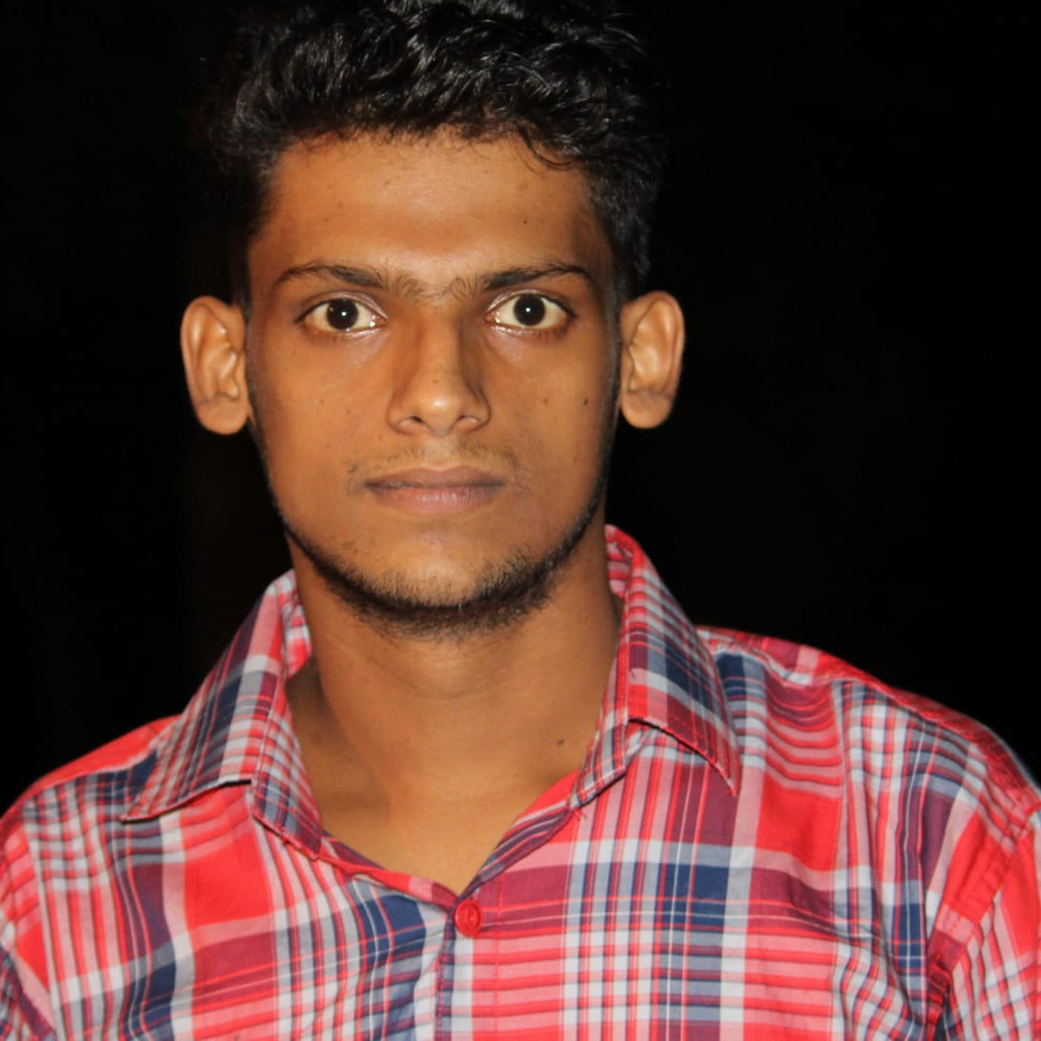


RAKESH KUMAR
Analyst/Software Engineer
BACHELOR OF TECHNOLOGY
Computer Science & Engineering
2017-2021
Skills
C#
C++
Python
.NET core
ADO. Net
ASP. Net Core MVC
Entity Framework
Django
DatabaseL
MS SQL Server 2014
Web Technologies
HTML5
CSS3
Java Script
Bootstrap
Additional skills
Leadership Qualities
Quick Learner
Team Management
Hobbies & Interest
Playing Cricket
Helping to Other
BANGALORE
rakesh.ao.kumar@capgemini.com
+91 8294027217
A4
Eager to work in a team of dedicated people and serve a key role in the enhancement and development of the project.
Software Engineer who is Strong in design and integration with intuitive problem-solving skills. Passionate about implementing and launching new projects.
Ready to learn new technologies and implement them to further improve my knowledge.
Hands on experience in creating microservices with C#,ASP.NET MVC Framework ,HTML5,CSS and SQL Server.
.
Jungle Safari management System:
Completed end to end case study of Jungle Safari Management System along with C# ,.NET Framework, ASP .NET CORE MVC, and , html, CSS, Bootstrap for user interface.
* I have done training on python From Softwizz Technology Pvt Ltd.
Project Tittle: E-Commerce Website
Project Description: The project used python Django framework html, css, javascript ,Ajax for making a E-commerce website with paypal payment gateway
Check out my work on GitHub & Video Profile

